Slide 1
CDI Resolución de Ejercicios

Slide 2
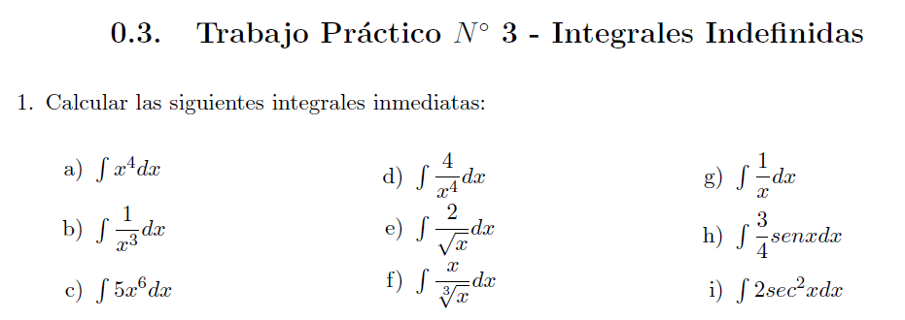

Slide 3








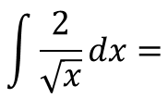
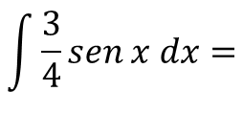
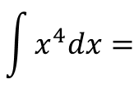
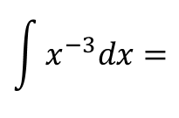
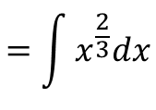
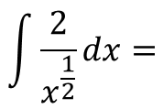


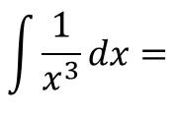
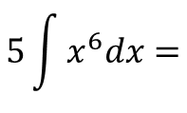

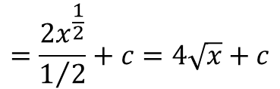
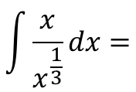
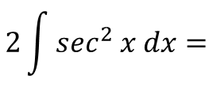
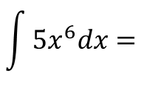
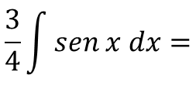


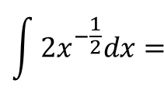
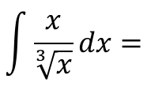
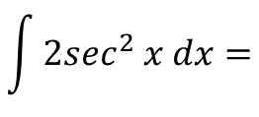
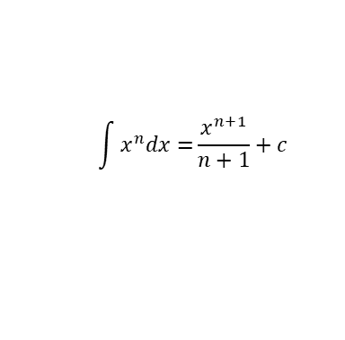
$$\int{x^{n}dx=}\frac{x^{n+1}}{n+1}+c$$
$$\int{x^{4}dx=}$$
$$\frac{x^{4+1}}{4+1}+c=$$
$$\frac{x^{5}}{5}+c$$
$$\int{\frac{x}{\sqrt[3]{x}}dx=}$$
$$\int{\frac{x}{x^{\frac{1}{3}}}dx=}$$
$$=\int{x^{\frac{2}{3}}dx}$$
Similar al punto e)
$$\int{\frac{1}{x^{3}}dx=}$$
$$\int{x^{−3}dx=}$$
$$\frac{x^{−2}}{−2}=\frac{1}{−2x^{2}}+c$$
$$\int{\frac{3}{4}sen x dx=}$$
$$\frac{3}{4}\int{sen x dx}=$$
$$\int{{5x}^{6}dx=}$$
$$5\int{x^{6}dx}=$$
$$\frac{ 5}{ 7}x^{7}+c$$
$$=−\frac{3}{4}\cos{x}+c$$
$$\int{\frac{2}{\sqrt{x}}dx=}$$
$$\int{\frac{2}{x^{\frac{1}{2}}}dx=}$$
$$\int{{2x}^{−\frac{1}{2}}dx=}$$
$$\int{{2sec}^{2} x dx=}$$
$$2\int{\sec^{2} x dx=}$$
$$=\frac{{2x}^{\frac{1}{2}}}{1/2}+c=4\sqrt{x}+c$$
$$=2\operatorname{tg}{x+c}$$

Slide 4
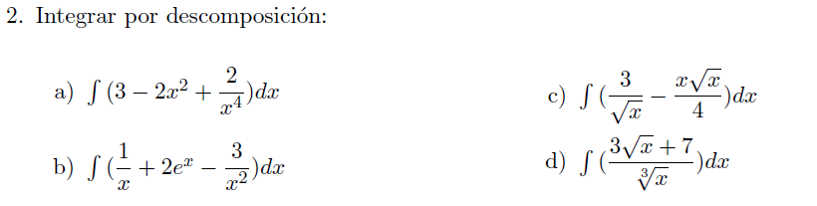


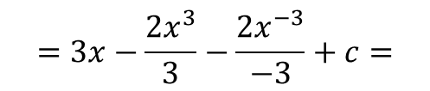
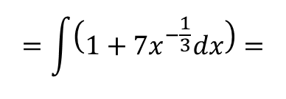
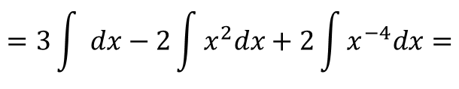
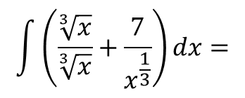
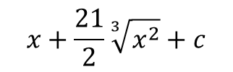
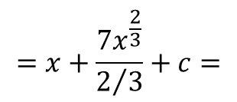
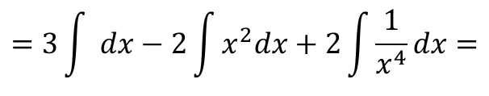
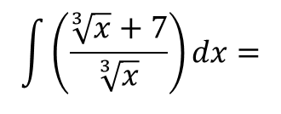
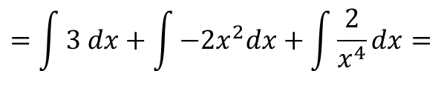
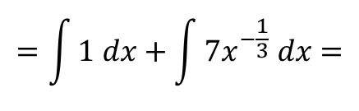
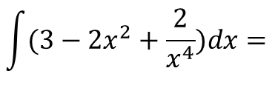
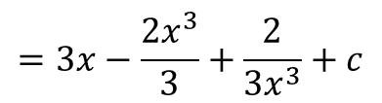
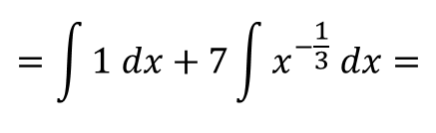
$$\int{(3−2x^{2}+\frac{2}{x^{4}})dx=}$$
$$\int{\left(\frac{\sqrt[3]{x}+7}{\sqrt[3]{x}}\right)dx}=$$
$$\int{\left(\frac{\sqrt[3]{x}}{\sqrt[3]{x}}+\frac{7}{x^{\frac{1}{3}}}\right)dx}=$$
$$=\int{3 dx}+\int{−2x^{2}dx}+\int{\frac{2}{x^{4}}dx}=$$
$$=\int{\left(1+{7x}^{−\frac{1}{3}}dx\right)=}$$
$$=3\int{ dx}−2\int{x^{2}dx}+2\int{\frac{1}{x^{4}}dx}=$$
$$=\int{1 dx}+\int{7x^{−\frac{1}{3}} dx}=$$
$$=3\int{ dx}−2\int{x^{2}dx}+2\int{x^{−4}dx}=$$
$$=\int{1 dx}+7\int{x^{−\frac{1}{3}} dx}=$$
$$=3x−\frac{2x^{3}}{3}−\frac{2x^{−3}}{−3}+c=$$
$$=x+\frac{7x^{\frac{2}{3}}}{2/3}+c=$$
$$x+\frac{21}{2}\sqrt[3]{x^{2}}+c$$
$$=3x−\frac{2x^{3}}{3}+\frac{2}{3x^{3}}+c$$

Slide 5
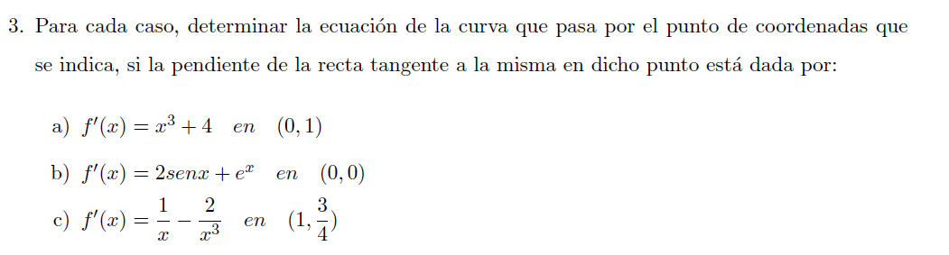

Slide 6





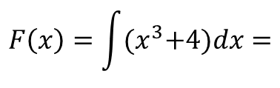
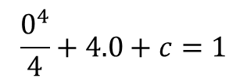



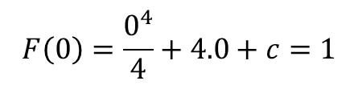
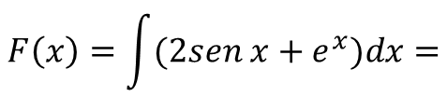





$$c=1$$
$$F\left(x\right)=\int{{(x}^{3}+4)dx=}$$
$$\frac{x^{4}}{4}+4x+c$$
$$∴F\left(x\right)=−2\cos{x {+e}^{x}}+1$$
$$F\left(0\right)=\frac{0^{4}}{4}+4.0+c=1$$
$$F\left(0\right)=1⇒$$
$$\frac{0^{4}}{4}+4.0+c=1$$
$$⇒c=1$$
$$∴F\left(x\right)=\frac{x^{4}}{4}+4x+1$$
$$F\left(x\right)=\int{(2sen x+e^{x})dx=}$$
$$−2\cos{x {+e}^{x}}+c$$
$$F\left(0\right)=0⇒$$
$$F\left(0\right)=−2\cos{0 {+e}^{0}}+c=0$$
$$−2\cos{0 {+e}^{0}}+c=0⇒$$
$$−2+1+c=0⇒$$

